Slide 1

J
Capstone Project Phase A
25-2-D-2
Interpersonal Synchrony and Leader–Follower Detection
Development of a Module for Leader–Follower Detection
Using Pose Estimation and Time-Lagged Cross-Correlation
Presented by:
Shahed Shalabi
Janet Ibrahem
Supervisors:
Anat Dahan
Ayala Dante

Slide 2

AGENDA
J
Project Overview
Interpersonal Synchrony & Leader–Follower Dynamics, Mirror Game Example, Pose Estimation Using Landmarks & MediaPipe, Time-Lagged Cross-Correlation (TLCC)
1
System & Algorithm Design
Overview of InterSync System, Our Proposed Algorithm, Synchrony Pipeline Stages: ROI, Averaging, TLCC, Peak Detection, Inference
2
3
Prototype & Evaluation
·Uploading Video & Selecting ROI, Setting TLCC Parameters, Displaying Analysis Results (Lag Graph + Video Frame), Testing Plan & Validation via Annotated or Controlled Datasets

Slide 3


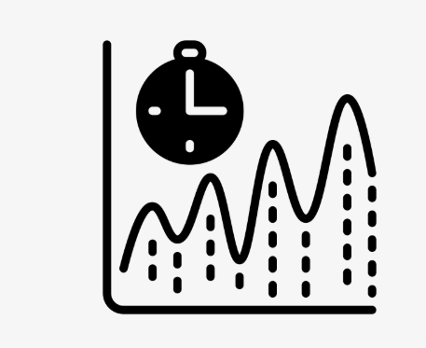
Interpersonal synchrony
1
J
Naturally occurs in social interactions
Can be intentional or spontaneous
Measured using time-series analyses of movement, timing, and rhythm

Slide 4



s
1
Leader–Follower Dynamics
One participant leads the motion, the other follows slightly later
Directionality is not always stable– roles may switch over time
Two main modes: • LF (Leader–Follower)- one leads, one mirrors • Co-motion mutual movement without clear leader

Slide 5
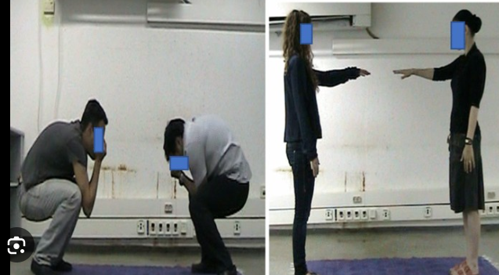
s
1
Visual example from Mirror Game paradigm, One person leads a movement the other follows Used to study synchrony and role shifts in real time

Slide 6
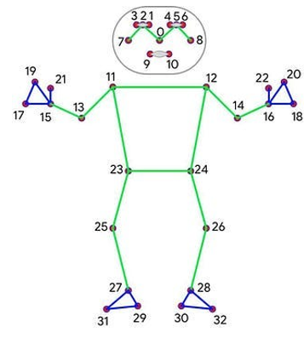
Core Components of the System: Pose Estimation and Synchrony Analysis Tools
J+s
1
Time-Lagged Cross-Correlation (TLCC)
Landmarks
MediaPipe
A real-time framework for extracting 3D body landmarks from video using deep learning.
Computes the correlation between two movement signals with varying time lags to identify who leads and who follows

Slide 7




InterSync – Existing System Overview
S
2
Developed to analyze interpersonal synchrony:
measures how well participants move together over time
Analyzes synchrony between participants using extracted body landmarks
Limitation: No support for directionality (Leader–Follower)
Employs MediaPipe for landmark extraction

Slide 8



Our Algorithm – General Overview
2
J
Enhances InterSync by detecting leader–follower roles via pose-based synchrony
Uses TLCC on ROI motion to capture temporal dynamics.

Slide 9
Leader–Follower Detection: Pipeline Overview
2
1
ROI Selection
4
Time-Lagged Cross-Correlation (TLCC) per Window
2
Averaging Multiple Joint Landmarks within a Single ROI (Per Participant)
5
Peak Synchrony Window Identification
3
Temporal Segmentation
6
Leader–Follower Inference

Slide 10
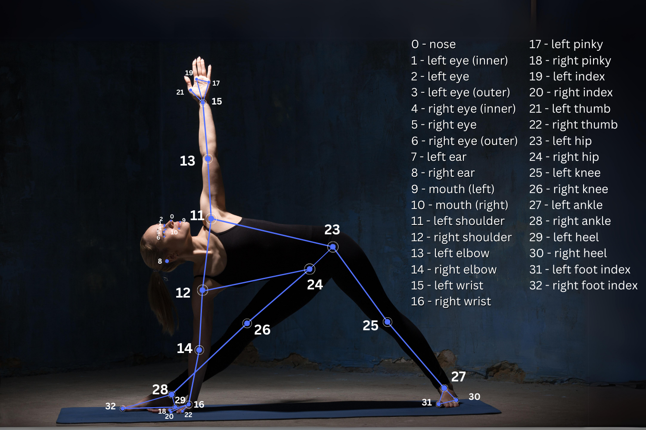
Leader–Follower Detection: Pipeline Overview
2
s
1
ROI Selection

Slide 11
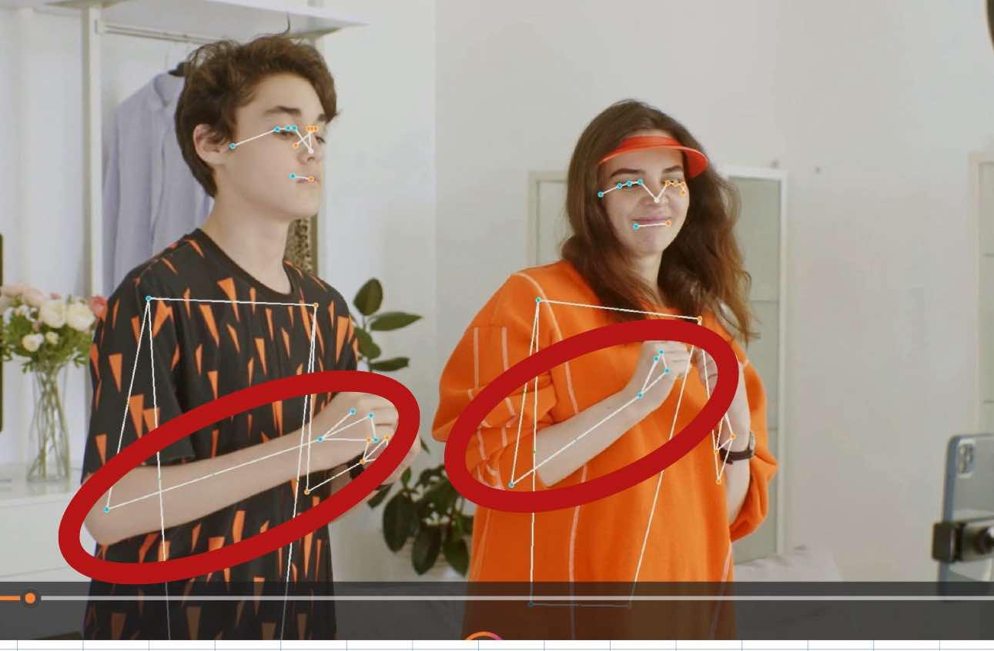
Leader–Follower Detection: Pipeline Overview
2
s
2
Averaging Multiple Joint Landmarks within a Single ROI (Per Participant)

Slide 12
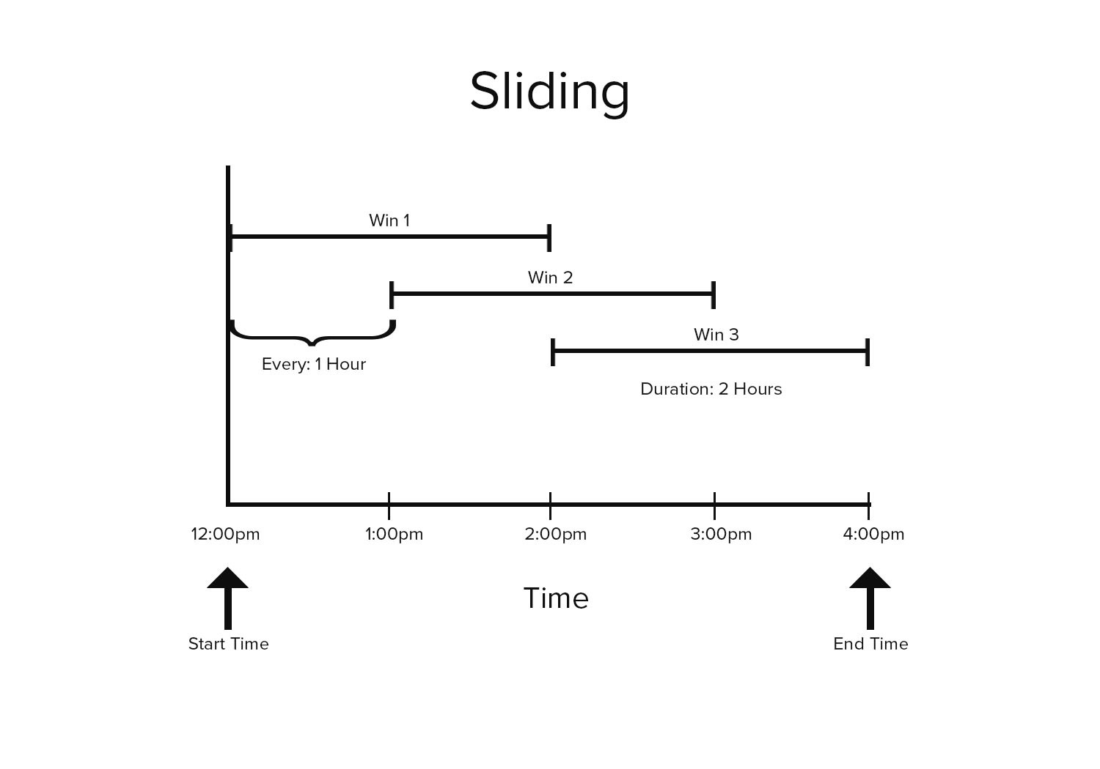

Leader–Follower Detection: Pipeline Overview
2
s
3
Temporal Segmentation

Slide 13
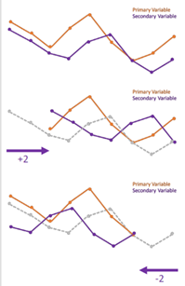
Leader–Follower Detection: Pipeline Overview
2
j
4
Time-Lagged Cross-Correlation (TLCC) per Window

Slide 14
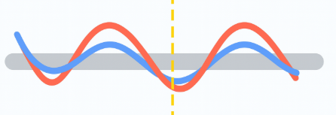
Leader–Follower Detection: Pipeline Overview
2
j
5
Peak Synchrony Window Identification

Slide 15
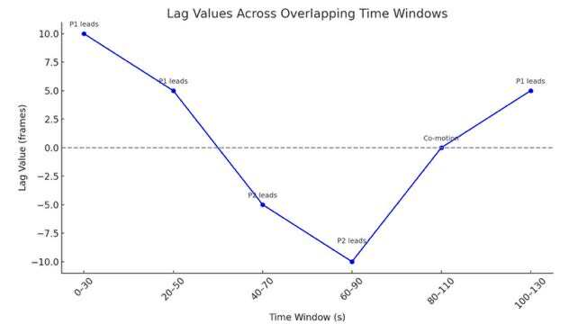
Leader–Follower Detection: Pipeline Overview
2
j
6
Leader–Follower Inference

Slide 16
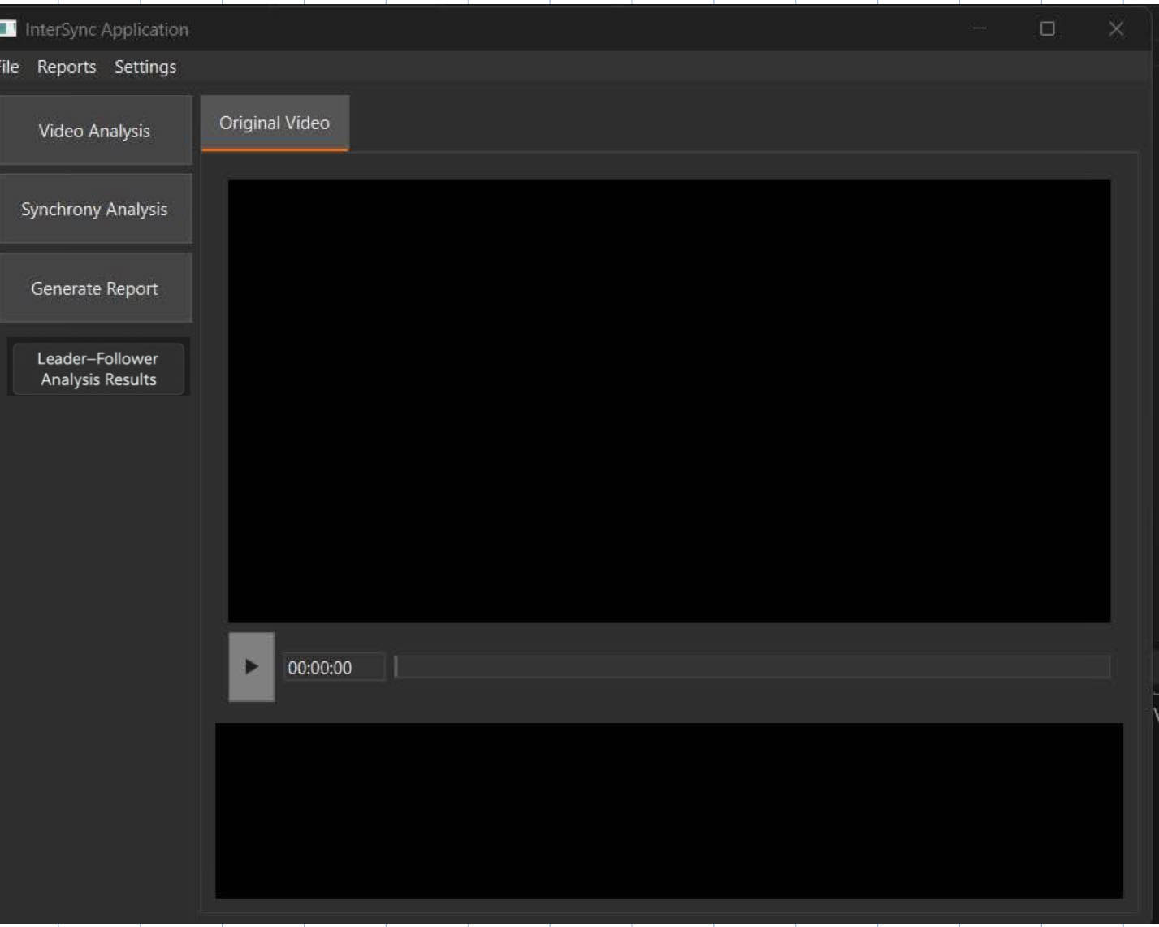

s
3
PROTOTYPE SCREENS
Uploading a Video
The user uploads a video featuring two individuals engaged in interaction.
This video serves as the input for synchrony and leader–follower analysis.

Slide 17

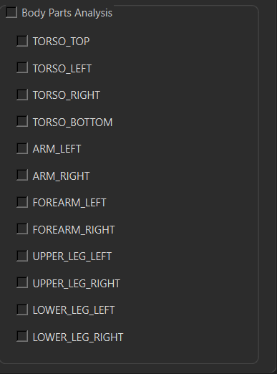
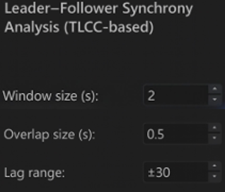
s
PROTOTYPE SCREENS
Defining ROI and TLCC Parameters for Leader–Follower Detection
3
Body Part Selection
TLCC Analysis Settings
The user sets three TLCC parameters
The user selects a Region of Interest (ROI), such as the arm or leg. A 3D motion vector is computed for each participant
and used in TLCC analysis to detect leader–follower dynamics.

Slide 18
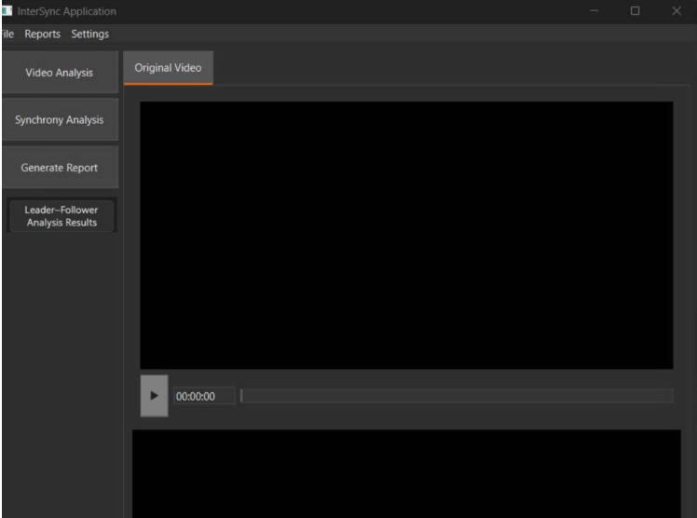
Clicking the Leader–Follower Analysis Results button displays the TLCC analysis output
J
PROTOTYPE SCREENS
Displaying Leader–Follower Results
3

Slide 19
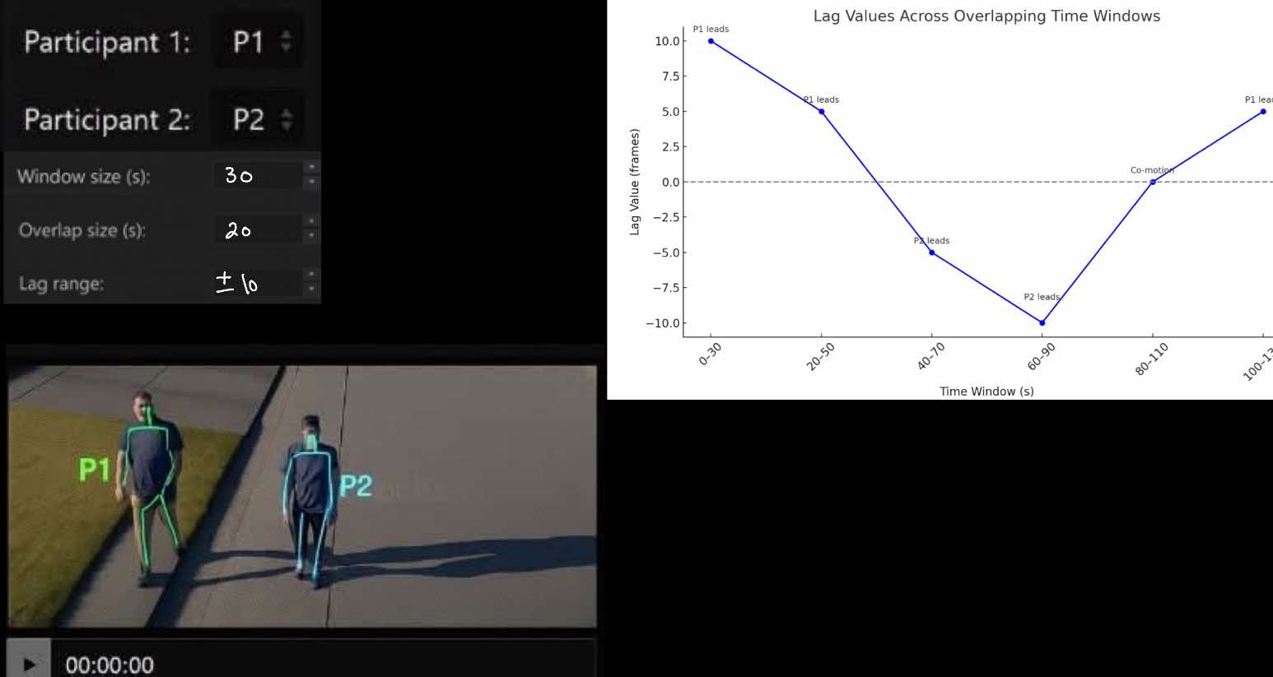
J
PROTOTYPE SCREENS Visual Output: Leader–Follower Dynamics
3
This screen provides:
A lag graph that visualizes shifts in leadership roles across time.
A frame from the video with labeled participants (P1/P2) , illustrating the process.
User-defined parameters (window length, overlap, lag range) shown for reproducibility.
Lag Graph by Overlapping Time Windows

Slide 20




testing and validation process
3
s
Search for Public Datasets Explore publicly available video datasets with ground truth leader–follower labels for each time window.
Manual Annotation If no dataset is found, manually annotate selected videos by visually identifying who leads and who follows.
Controlled Recordings Create test videos where participants are instructed to lead or follow, then compare system output to expected roles.

Slide 21

Thank you!

